Slide 1

AI-based Clinical Decision Support System for Heart Patients
Abstract
Benefits, Challenges and Ethical Considerations
KFUPM Snapshot
This study introduces an AI-based Clinical Decision Support System (CDSS) for heart patients to help patients and healthcare providers diagnose, treat, and manage heart diseases. The proposed system uses real- time wearable and IoT data, machine learning algorithms, and natural language processing to give individualized care and evidence-based treatment suggestions. Data input, AI processing, warning and suggestion interfaces, and clinical decision interfaces are system components. Using real time patient data and medical literature, the system can increase diagnosis accuracy, intervention time, and patient outcomes. This research also discusses challenges such as user acceptability, data protection, and smooth integration into healthcare operations.
Implementing the proposed AI-based CDSS offers numerous benefits, including improved diagnostic accuracy, personalised care, enhanced efficiency, better patient outcomes and cost reduction. The system can be deployed as a web-based or mobile application, increasing its accessibility and ease of use. Despite its potential, the proposed AI-based CDSS might face several challenges, such as building user trust and acceptance, managing potential errors, and addressing ethical concerns related to data privacy and algorithm bias. Another potential challenge could be to integrate the system with clinical workflow. For successful adoption, the CDSS must seamlessly integrate into existing clinical workflows without interrupting the care process. This requires careful design and collaboration with healthcare providers.
Dhahran, Saudi Arabia
Introduction
Conclusion and Contributions
This study introduces an AI-based Clinical Decision Support System (CDSS) for heart patients to help patients and healthcare providers diagnose, treat, and manage heart diseases. The proposed system uses real- time we/arable and IoT data, machine learning algorithms, and natural language processing to give individualized care and evidence-based treatment suggestions. Data input, AI processing, warning and suggestion interfaces, and clinical decision interfaces are system components. Using real time patient data and medical literature, the system can increase diagnosis accuracy, intervention time, and patient outcomes. This research also discusses challenges such as user acceptability, data protection, and smooth integration into healthcare operations.
The proposed AI-based CDSS represents a significant advancement in healthcare, particularly in the management of patients’ heart conditions. It offers the potential to identify emergency heart issues, enhance diagnostic accuracy, personalise treatment, and improve patient outcomes. While computerised CDSS has previously been applied in dealing various health- related issues such as ventilator management, developmental surveillance and screening, and traumatic brain injury (Carrol et al., 2014; Dayan et al., 2017; Hotz et al., 2020), the proposed AI-based CDSS is a novel addition, uniquely capable of diagnosing and treating heart-related issues using real-time data. Moreover, unlike, existing AI-based clinical decision systems that primarily rely on previously recorded data (e.g. electronic health records, medical imaging and patient health logs) (Comito et al., 2022), the proposed AI-based CDSS introduces the innovative use of real-time data from individual patients to determine the need for emergency interventions.
Students from 80+ countries
40% graduate students
Architecture
This study introduces an AI-based Clinical Decision Support System (CDSS) for heart patients to help patients and healthcare providers diagnose, treat, and manage heart diseases. The proposed system uses real- time wearable and IoT data, machine learning algorithms, and natural language processing to give individualized care and evidence-based treatment suggestions. Data input, AI processing, warning and suggestion interfaces, and clinical decision interfaces are system components. Using real time patient data and medical literature, the system can increase diagnosis accuracy, intervention time, and patient outcomes. This research also discusses challenges such as user acceptability, data protection, and smooth integration into healthcare operations.
References
Carroll, A. E., Bauer, N. S., Dugan, T. M., Anand, V., Saha, C., and Downs. 2014.
“Use of a computerized decision aid for developmental surveillance and screening: a randomized clinical trial,” JAMA Pediatr (168:9), pp. 815–821.
Comito, C., Falcone, D., and Forestiero, A. 2022. "AI-Driven Clinical Decision Support: Enhancing Disease Diagnosis Exploiting Patients Similarity," IEEE
Access (10) pp. 6878-6888.
Dayan, P. S. et al. 2017. “Use of traumatic brain injury prediction rules with clinical decision support,” Pediatrics (139), e20162709.
Hotz, J. C., Bornstein, D., Kohler, K., Smith, E., Suresh, A., Klein, M., Bhalla, A., Newth, C. J., Khemani, R. G. 2020. “Real-time effort driven ventilator
management: a pilot study,” Pediatr. Crit. Care Med (21), pp. 933–940.
50% female engineering enrollment
Method
#63 worldwide
This study introduces an AI-based Clinical Decision Support System (CDSS) for heart patients to help patients and healthcare providers diagnose, treat, and manage heart diseases. The proposed system uses real- time wearable and IoT data, machine learning algorithms, and natural language processing to give individualized care and evidence-based treatment suggestions. Data input, AI processing, warning and suggestion interfaces, and clinical decision interfaces are system components. Using real time patient data and medical literature, the system can increase diagnosis accuracy, intervention time, and patient outcomes. This research also discusses challenges such as user acceptability, data protection, and smooth integration into healthcare operations.
Acknowledgements
This project is funded by the Interdisciplinary Research Center (IRC) for Finance and Digital Economy (IRC-FDE) at King Fahd University of Petroleum & Minerals under Grant No. INFE2412.
AI+XTM
Minhajul Islam Ukil and Mousa Albashrawi
Interdisciplinary Research Center for Finance and Digital Economy,
0-0-0 Policy
DREAM BIG AND ACCOMPLISH

Slide 2



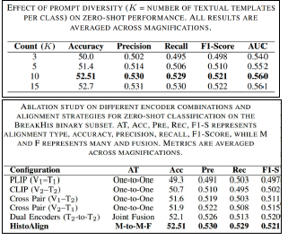
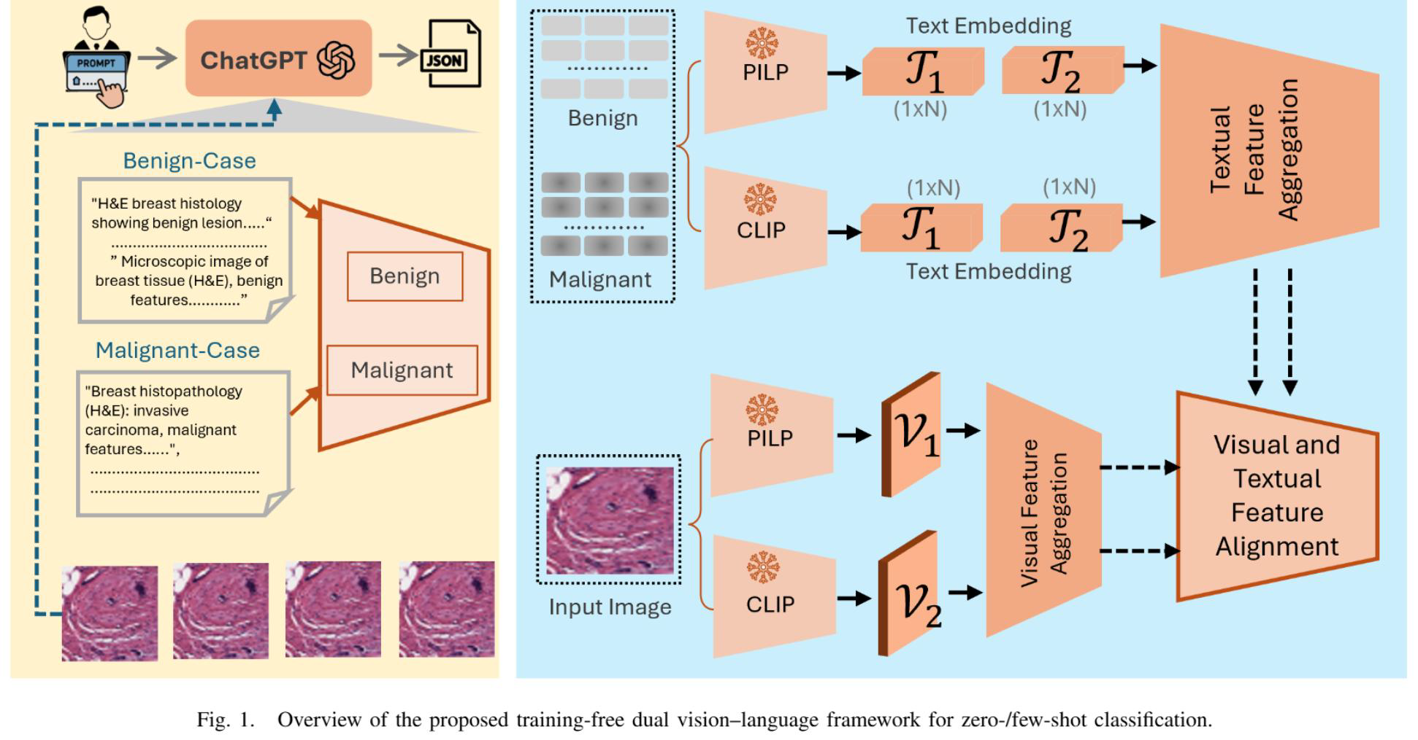
HistoAlign: A Dual-Encoder Many-to-Many Alignment Framework for Zero-Shot Histopathology Classificationtle
Poster No.
A02-007
Quratulain Arshad1, Nour Aburaed2, Muzammil Behzad1,3
3SDAIA-KFUPM Joint Research Center for Artificial Intelligence,
INTRODUCTION
KFUPM Snapshot
Histopathology image analysis is essential for computer-aided cancer diagnosis and treatment planning.
Deep learning models achieve strong performance but require large, expertly annotated datasets, which are costly and limited in availability.
In addition, domain shifts caused by staining, scanners, and tissue preparation reduce generalization across clinical centers.
Vision language models enable zero-shot learning by aligning images with clinical text, reducing dependence on labelled data.
However, generic models such as CLIP struggle with complex histopathology patterns, motivating domain-aware cross-modal alignment.
Dhahran, Saudi Arabia
METHODOLOGY
The proposed framework, termed HistoAlign, introduces a dual-encoder zero-shot learning approach for breast histopathology image classification.
HistoAlign combines two complementary vision-language encoders:
(i) a pathology-aware encoder, PLIP, pretrained on biomedical figure-caption pairs to capture domain-specific cellular morphology, and
(ii) a generic CLIP encoder pretrained on large-scale natural image-text corpora to enhance semantic generalization.
The integration of these encoders enables a robust many-to-many alignment between visual and textual modalities. The entire framework consists of five key stages:
(1) image preprocessing,
(2) domain-aware prompt construction,
(3) dual-encoder representation learning,
(4) multi-level class similarity, and (5) zero-shot inference.
Students from 80+ countries
40% graduate students
OBJECTIVES
50% female engineering enrollment
Implementing the proposed AI-based CDSS offers numerous benefits, including improved diagnostic accuracy, personalised care, enhanced efficiency, better patient outcomes and cost reduction. The system can be deployed as a web-based or mobile application, increasing its accessibility and ease of use. Despite its potential, the proposed AI-based CDSS might face several challenges, such as building user trust and acceptance, managing potential errors, and addressing ethical concerns related to data privacy and algorithm bias. Another potential challenge could be to integrate the system with clinical workflow. For successful adoption, the CDSS must seamlessly integrate into existing clinical workflows without interrupting the care process. This requires careful design and collaboration with healthcare providers.
#63 worldwide
RESULTS
Comprehensive experiments on the BreakHis dataset, including a curated 10-folder binary subset, demonstrated that HistoAlign can transfer semantic knowledge from large-scale natural image-text pairs to highly domain specific medical imagery
Across all evaluations, the model achieved an overall accuracy of 52.51% and an AUC of 0.56 on the curated BreakHis binary subset, establishing a reliable baseline for domain adaptation in medical zero-shot learning.
While the results are modest compared to fully supervised benchmarks, they demonstrate that cross-modal alignment between visual and textual representations can successfully transfer coarse semantic understanding to specialized medical imagery without any fine-tuning
AI+XTM
CONCLUSIONS
0-0-0 Policy
This project is funded by the Interdisciplinary Research Center (IRC) for Finance and Digital Economy (IRC-FDE) at King Fahd University of Petroleum & Minerals under Grant No. INFE2412.
DREAM BIG AND ACCOMPLISH

