Slide 1

AI-based Clinical Decision Support System for Heart Patients
Minhajul Islam Ukil and Mousa Albashrawi
Interdisciplinary Research Center for Finance and Digital Economy,
Abstract
Conclusion and Contributions
This study introduces an AI-based Clinical Decision Support System (CDSS) for heart patients to help patients and healthcare providers diagnose, treat, and manage heart diseases. The proposed system uses real- time wearable and IoT data, machine learning algorithms, and natural language processing to give individualized care and evidence-based treatment suggestions. Data input, AI processing, warning and suggestion interfaces, and clinical decision interfaces are system components. Using real time patient data and medical literature, the system can increase diagnosis accuracy, intervention time, and patient outcomes. This research also discusses challenges such as user acceptability, data protection, and smooth integration into healthcare operations.
The proposed AI-based CDSS represents a significant advancement in healthcare, particularly in the management of patients’ heart conditions. It offers the potential to identify emergency heart issues, enhance diagnostic accuracy, personalise treatment, and improve patient outcomes. While computerised CDSS has previously been applied in dealing various health- related issues such as ventilator management, developmental surveillance and screening, and traumatic brain injury (Carrol et al., 2014; Dayan et al., 2017; Hotz et al., 2020), the proposed AI-based CDSS is a novel addition, uniquely capable of diagnosing and treating heart-related issues using real-time data. Moreover, unlike, existing AI-based clinical decision systems that primarily rely on previously recorded data (e.g. electronic health records, medical imaging and patient health logs) (Comito et al., 2022), the proposed AI-based CDSS introduces the innovative use of real-time data from individual patients to determine the need for emergency interventions.
Introduction
This study introduces an AI-based Clinical Decision Support System (CDSS) for heart patients to help patients and healthcare providers diagnose, treat, and manage heart diseases. The proposed system uses real- time wearable and IoT data, machine learning algorithms, and natural language processing to give individualized care and evidence-based treatment suggestions. Data input, AI processing, warning and suggestion interfaces, and clinical decision interfaces are system components. Using real time patient data and medical literature, the system can increase diagnosis accuracy, intervention time, and patient outcomes. This research also discusses challenges such as user acceptability, data protection, and smooth integration into healthcare operations.
References
Carroll, A. E., Bauer, N. S., Dugan, T. M., Anand, V., Saha, C., and Downs. 2014.
“Use of a computerized decision aid for developmental surveillance and screening: a randomized clinical trial,” JAMA Pediatr (168:9), pp. 815–821.
Comito, C., Falcone, D., and Forestiero, A. 2022. "AI-Driven Clinical Decision Support: Enhancing Disease Diagnosis Exploiting Patients Similarity," IEEE
Access (10) pp. 6878-6888.
Dayan, P. S. et al. 2017. “Use of traumatic brain injury prediction rules with clinical decision support,” Pediatrics (139), e20162709.
Hotz, J. C., Bornstein, D., Kohler, K., Smith, E., Suresh, A., Klein, M., Bhalla, A., Newth, C. J., Khemani, R. G. 2020. “Real-time effort driven ventilator
management: a pilot study,” Pediatr. Crit. Care Med (21), pp. 933–940.
Architecture
This study introduces an AI-based Clinical Decision Support System (CDSS) for heart patients to help patients and healthcare providers diagnose, treat, and manage heart diseases. The proposed system uses real- time wearable and IoT data, machine learning algorithms, and natural language processing to give individualized care and evidence-based treatment suggestions. Data input, AI processing, warning and suggestion interfaces, and clinical decision interfaces are system components. Using real time patient data and medical literature, the system can increase diagnosis accuracy, intervention time, and patient outcomes. This research also discusses challenges such as user acceptability, data protection, and smooth integration into healthcare operations.
Acknowledgements
This project is funded by the Interdisciplinary Research Center (IRC) for Finance and Digital Economy (IRC-FDE) at King Fahd University of Petroleum & Minerals under Grant No. INFE2412.
Benefits, Challenges and Ethical Considerations
Method
Implementing the proposed AI-based CDSS offers numerous benefits, including improved diagnostic accuracy, personalised care, enhanced efficiency, better patient outcomes and cost reduction. The system can be deployed as a web-based or mobile application, increasing its accessibility and ease of use. Despite its potential, the proposed AI-based CDSS might face several challenges, such as building user trust and acceptance, managing potential errors, and addressing ethical concerns related to data privacy and algorithm bias. Another potential challenge could be to integrate the system with clinical workflow. For successful adoption, the CDSS must seamlessly integrate into existing clinical workflows without interrupting the care process. This requires careful design and collaboration with healthcare providers.
This study introduces an AI-based Clinical Decision Support System (CDSS) for heart patients to help patients and healthcare providers diagnose, treat, and manage heart diseases. The proposed system uses real- time wearable and IoT data, machine learning algorithms, and natural language processing to give individualized care and evidence-based treatment suggestions. Data input, AI processing, warning and suggestion interfaces, and clinical decision interfaces are system components. Using real time patient data and medical literature, the system can increase diagnosis accuracy, intervention time, and patient outcomes. This research also discusses challenges such as user acceptability, data protection, and smooth integration into healthcare operations.
KFUPM Snapshot
DREAM BIG AND ACCOMPLISH
Dhahran,
Saudi Arabia
Students from 80+ countries
40% graduate students
50% female engineering enrollment
#63 worldwide
AI+XTM
0-0-0 Policy

Slide 2
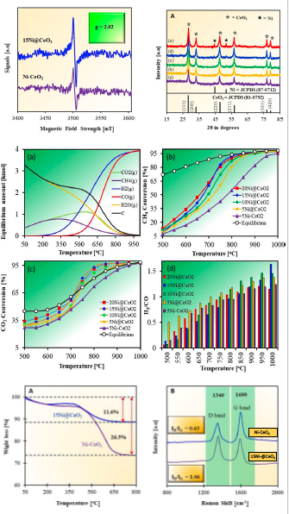


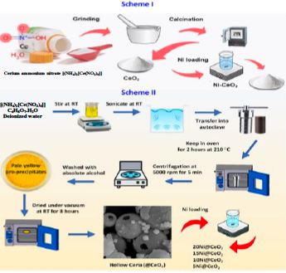
Hollow Sphere Ni/CeO₂ Catalyst for Efficient Syngas Production via Dry Reforming of Methane
Poster No.
A02-007
Ijaz Hussain a, Khalid Alhooshani a, b, Saheed A. Ganiyu a, b
- Interdisciplinary Research Center for Refining & Advanced Chemicals - Department of Chemistry
Abstract
Results & Discussion
A hollow-sphere Ni@CeO₂ catalyst was developed for efficient DRM. The structure enhanced oxygen mobility and Ni stability. At 15 wt% Ni, the catalyst achieved 83% CH₄ and 81% CO₂ conversions at 750°C (H₂/CO = 0.79). Higher Ni loadings led to agglomeration and reduced activity. The presence of oxygen vacancies and elevated surface basicity was found to significantly enhance DRM activity.
Introduction
Synthesis of Catalyst
Conclusion:
Hollow-sphere Ni@CeO₂ catalysts showed enhanced oxygen mobility and stability for DRM. The optimal 15 wt% Ni catalyst achieved 83% CH₄ and 81% CO₂ conversions at 750 °C with a H₂/CO ratio of 0.79 and stable performance over 40 hours. Higher Ni loading led to agglomeration and a reduction in activity. This catalyst offers strong potential for durable syngas production for commercialization.
Acknowledgements:
This work was supported by the Interdisciplinary Research Center for Refining & Advanced Chemicals, KFUPM (Project #INRC2520)
KFUPM Snapshot
DREAM BIG AND ACCOMPLISH
Dhahran,
Saudi Arabia
Students from 80+ countries
40% graduate students
50% female engineering enrollment
#63 worldwide
AI+XTM
0-0-0 Policy

