Slide 1







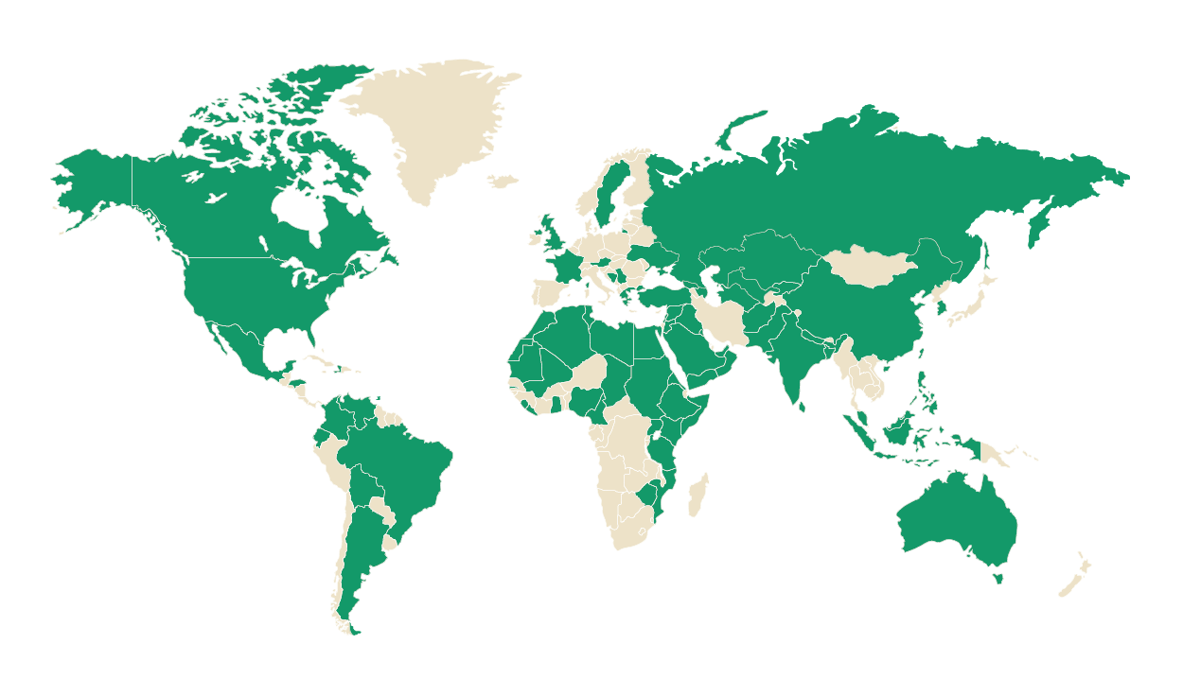








1
Our Home
Dhahran, Saudi Arabia
Driving to Bahrain, Qatar, UAE, Kuwait
3
Exclusive admission
3% admit-to-apply 1435 SAT bottom 25th percentile
Demands higher scores than medical schools
Dream Big
and Accomplish
2
Our Community
A diverse and thriving student body
4
Pivot into 10 Critical Sectors
No longer just Petroleum
80+
Countries of
students
40%
Graduate students
of total
50%
Female enrollment
in Engineering
Comprehensive Energy & Minerals
Chemicals & Materials
Manufacturing
Environment
& Sustainability
®
Mobility & Logistics
AI+X
Digital Economy
Where Every Discipline in Built on AI
Fintech
Aerospace & Defense
Biotechnology
Design & Built Environment
Notes:
1) Before I begin, let me take a minute to introduce my home institution, KFUPM. KFUPM is located in Dhahran, Saudi Arabia, at the center of one of the world's most important industrial, energy, and innovation ecosystems.
2) Today, our community includes students from more than 80 countries, with graduate students representing 40% of the student body. Although KFUPM only opened its doors to female undergraduate students in 2021, women now account for approximately 50% of engineering enrollment, an achievement that is exceptionally rare globally, where female participation in engineering programs often averages at around 10-25%.
3) With one of the lowest admission rates globally, approximately 3%, KFUPM attracts some of the world’s brightest students, individuals who truly embody our motto, Dream Big and Accomplish, and who will go on to shape the sectors of the future.
4) Speaking of the sectors of the future, while many people still associate KFUPM with petroleum, the university has pivoted far beyond it, into ten critical sectors that will shape future economies, including energy in general (for example: renewables, hydrogen, etc.), in addition to biotechnology, aerospace, fintech, manufacturing, sustainability, mobility, design, and the digital economy.
5) Central to all of these sectors is artificial intelligence. Long before the emergence of ChatGPT, KFUPM recognized that AI would become foundational across every industry. That's why we launched our AI+X model in 2020, where every student learns AI before their discipline, regardless of their major, so that we graduate professionals who are can effectively apply AI into their fields and industries.

Slide 2


















5
6
Driving Research Excellence
Exponential citations growth rate
7
Entrepreneurial Ecosystem
Supporting innovation without barriers
Global Standing
Consistent growth in top leading rankings
is
^{The 0-0-0 Zero Policy}
#63
0
Equity
0
Royalty
0
Fees
Worldwide
KFUPM allows its faculty to utilize its patents with zero strings attached, zero claw-back
^{KFUPM}
Ahead of
already
surpassed
Notes:
5) Innovation and entrepreneurship are also central to our University culture. One example is our 0-0-0 policy, which allows our faculty to commercialize the university’s IP into startups with 0 claw back of equity, royalties, or fees. This policy removes any potential barriers and enables great ideas to become real-world impact.
6) These efforts are reflected in our global standing. our research impact has grown at an exceptional pace, with citations per faculty now exceeding those of many top international universities.
7) And today, KFUPM is ranked #63 globally and is one of the fastest-rising universities in the world, ahead of leading universities.
Conclusion:
In short, KFUPM is a university focused on developing economy-creating talent, advancing research that serves humanity, and contributing to the sectors that will shape the future.
With that brief introduction to KFUPM, let me now turn to the focus of today's presentation...

Slide 3
Separator
Title
01

Slide 5
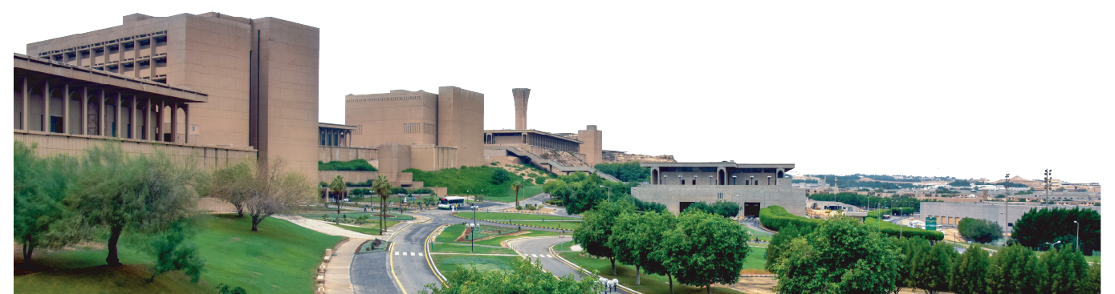
Presentation Title
Speaker Name

Slide 6
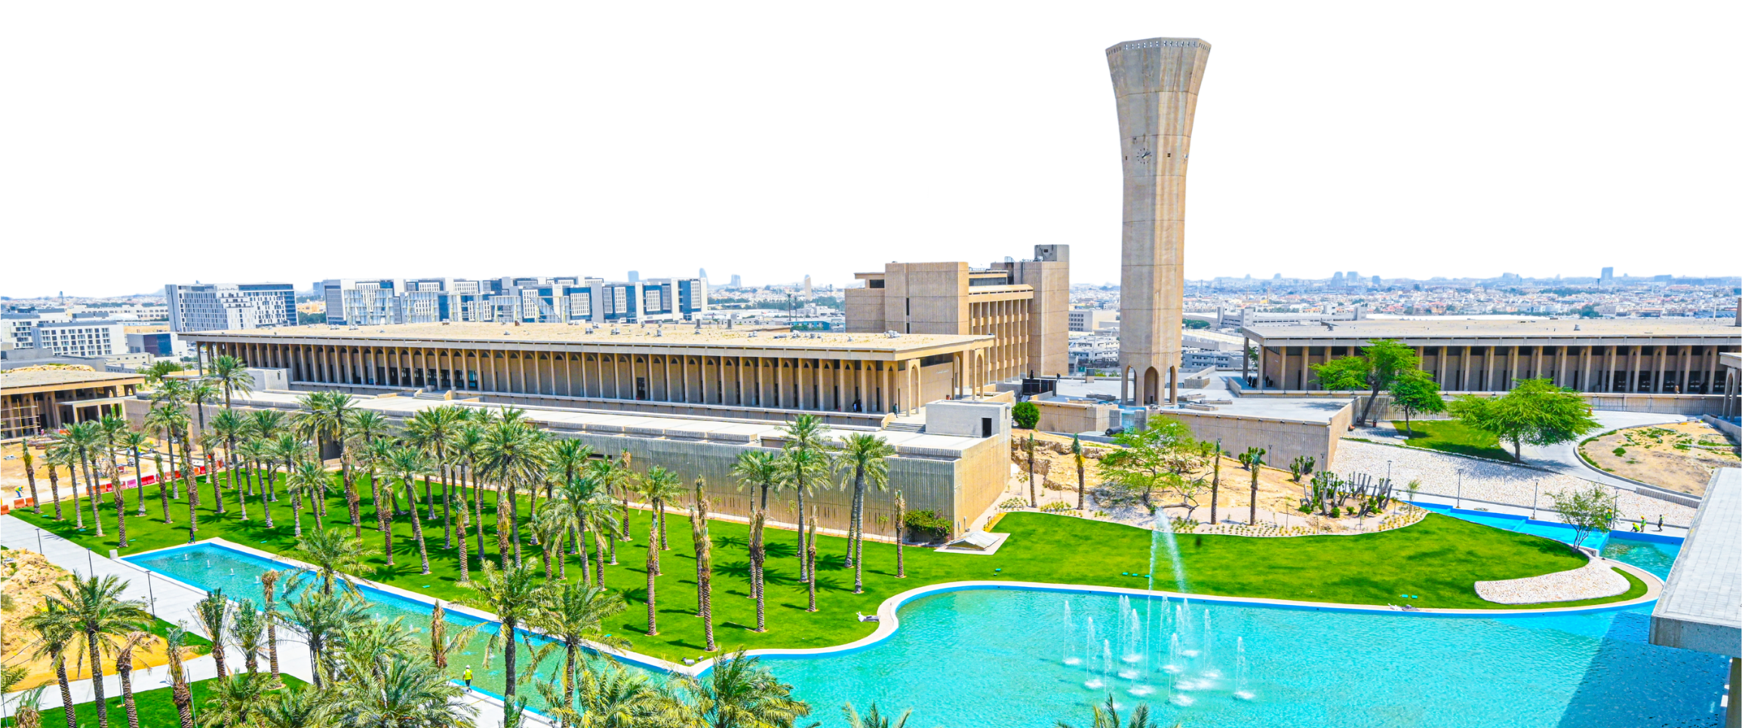
Presentation Title
Speaker Name

